Slide 1

CHAPTER 8
PROPERTIES OF RELATIONS
Copyright © Cengage Learning. All rights reserved.

Slide 2

8.1
Relations on Sets
Copyright © Cengage Learning. All rights reserved.

Slide 3
Example 8.1.1 – The Less-than Relation for Real Numbers
Define a relation L from R to R as follows: For all real numbers x and y,
x L y ⇔ x < y.
a. Is 57 L 53? b. Is (−17) L (−14)?
c. Is 143 L 143? d. Is (−35) L 1?
e. Draw the graph of L as a subset of the Cartesian plane R × R.

Slide 4
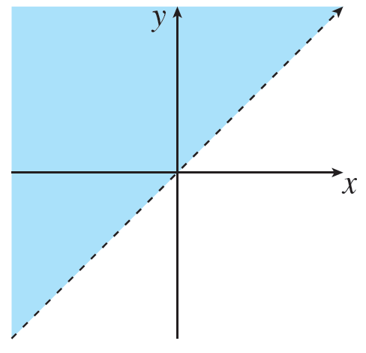
Example 8.1.1 – Solution
a. No, 57 > 53. b. Yes, −17 < −14.
c. No, 143 = 143. d. Yes, −35 < 1.
e. For each value of x, all the points (x, y) with y > x are on the graph. So the graph consists of all the points above the line x = y.

Slide 5
Example 8.1.2 – The Congruence Modulo 2 Relation
Define a relation E from Z to Z as follows: For every
(m, n) ∈ Z × Z,
m E n ⇔ m − n is even.
a. Is 4 E 0? Is 2 E 6? Is 3 E (−3)? Is 5 E 2?
b. List five integers that are related by E to 1.
c. Prove that if n is any odd integer, then n E 1.

Slide 6

Example 8.1.2 – Solution
a. Yes, 4 E 0 because 4 − 0 = 4 and 4 is even.
Yes, 2 E 6 because 2 − 6 = −4 and −4 is even.
Yes, 3 E (−3) because 3 − (−3) = 6 and 6 is even.
No,
because 5 − 2 = 3 and 3 is not even.

Slide 7
Example 8.1.2 – Solution
continued
b. There are many such lists. One is
1 because 1 − 1 = 0 is even.
3 because 3 − 1 = 2 is even.
5 because 5 − 1 = 4 is even.
−1 because −1 − 1 = −2 is even.
−3 because −3 − 1 = −4 is even.

Slide 8
Example 8.1.2 – Solution
continued
c. Proof: Suppose n is any odd integer. Then n = 2k + 1 for some integer k. Now by definition of E, n E 1 if, and only if, n − 1 is even.
But by substitution,
n − 1 = (2k + 1) − 1 = 2k,
and since k is an integer, 2k is even. Hence n E 1 [as was to be shown].

Slide 9
Example 8.1.2 – Solution
continued
It can be shown that integers m and n are related by E if, and only if, m mod 2 = n mod 2 (that is, both are even or both are odd).
When this occurs m and n are said to be congruent modulo 2.

Slide 10



Example 8.1.3 – A Relation on a Power Set
Let X = {a, b, c}.
Then
Define a relation S from
as follows: For all sets A and B in
(that is, for all subsets A and B of X),
A S B ⇔ A has at least as many elements as B.
a. Is {a, b} S {b, c}? b. Is {a} S
?
c. Is {b, c} S {a, b, c}? d. Is {c} S {a}?

Slide 11
Example 8.1.3 – Solution
a. Yes, both sets have two elements.
b. Yes, {a} has one element and
has zero elements, and 1 ≥ 0.
c. No, {b, c} has two elements and {a, b, c} has three elements and 2 < 3.
d. Yes, both sets have one element.

Slide 12
The Inverse of a Relation

Slide 13

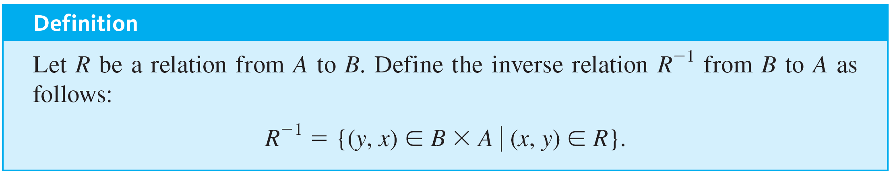

The Inverse of a Relation
from B to A can be defined by interchanging the elements of all the ordered pairs of R.
If R is a relation from A to B, then a relation
This definition can be written operationally as follows:

Slide 14


Example 8.1.4 – The Inverse of a Finite Relation
Let A = {2, 3, 4} and B = {2, 6, 8}, and let R be the “divides” relation from A to B: For every ordered pair (x, y) ∈ A × B,
, and draw arrow diagrams for R and
a. State explicitly which ordered pairs are in R and
b. Describe
in words.

Slide 15
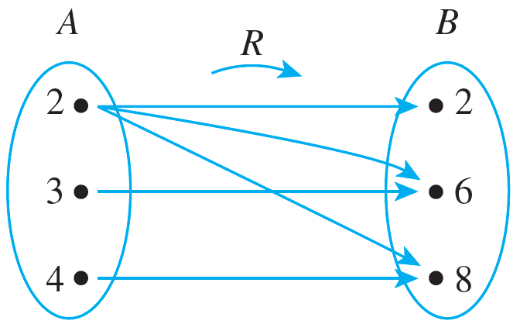
Example 8.1.4 – Solution
a. R = {(2, 2), (2, 6), (2, 8), (3, 6), (4, 8)}

Slide 16

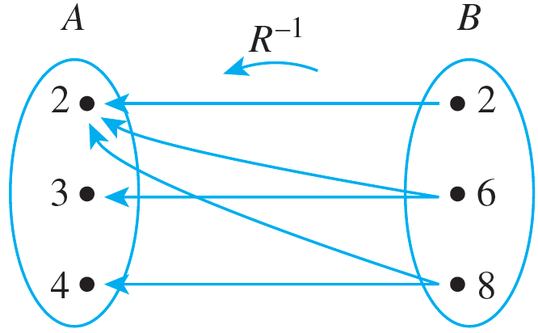
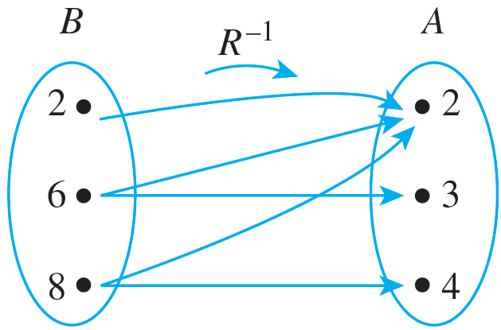
Example 8.1.4 – Solution
continued
To draw the arrow diagram for
you can copy the arrow diagram for R but reverse the directions of the arrows.
Or you can redraw the diagram so that B is on the left.

Slide 17

Example 8.1.4 – Solution
continued
can be described in words as follows: For every ordered pair (y, x) ∈ B × A,
y
b.
x ⇔ y is a multiple of x.

Slide 18

Example 8.1.5 – The Inverse of an Infinite Relation
Define a relation R from R to R as follows: For every ordered pair (x, y) ∈ R × R,
Draw the graphs of R and
in the Cartesian plane. Is
a function?

Slide 19


Example 8.1.5 – Solution
if, and only if, (u, v) is on the graph of R.
Note that if x ≥ 0, then the graph of
A point (v, u) is on the graph of
is a straight line with slope 2.
And if x < 0, then the graph of y =
= 2(−x) = −2x is a straight line with slope −2.

Slide 20
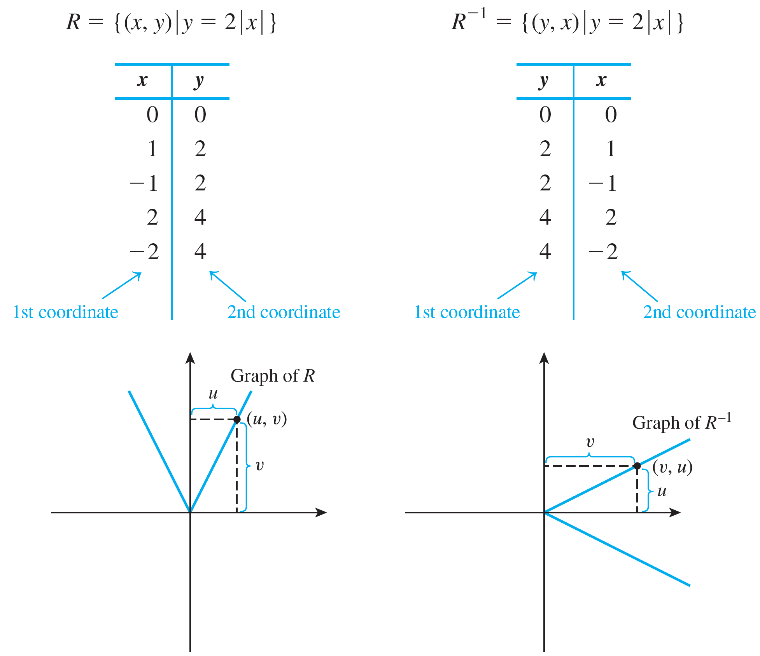

Example 8.1.5 – Solution
continued
Some sample values are tabulated and the graphs are shown below.
is not a function because, for instance, both (2, 1) and (2, −1) are in

Slide 21
Directed Graph of a Relation

Slide 22
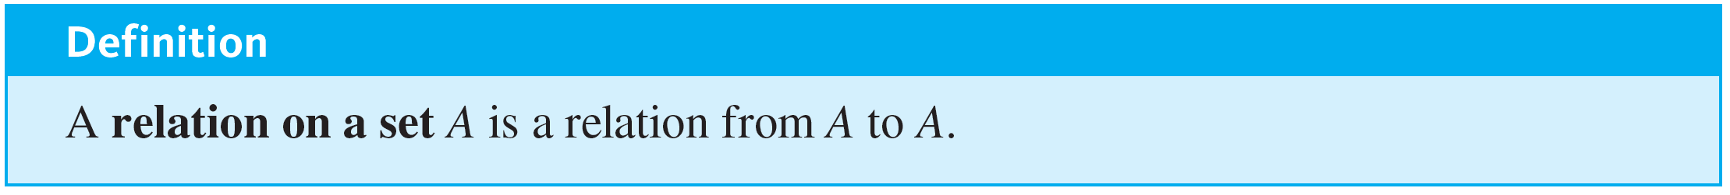
Directed Graph of a Relation
When a relation R is defined on a set A, the arrow diagram of the relation can be modified so that it becomes a directed graph.
Instead of representing A as two separate sets of points, represent A only once, and draw an arrow from each point of A to each related point.

Slide 23

Directed Graph of a Relation
As with an ordinary arrow diagram,

Slide 24

Example 8.1.6 – Directed Graph of a Relation
Let A = {3, 4, 5, 6, 7, 8} and define a relation R on A as follows: For every x, y ∈ A,
Draw the directed graph of R.

Slide 25


Example 8.1.6 – Solution
since 0 = 2 · 0. Thus there is a loop from 3 to itself. Similarly, there is a loop from 4 to itself, from 5 to itself, and so forth, since the difference of each integer with itself is 0, and
Note that 3 R 3 because 3 − 3 = 0 and
Note also that 3 R 5 because 3 − 5 = −2 = 2 · (−1). And 5 R 3 because 5 − 3 = 2 = 2 · 1. Hence there is an arrow from 3 to 5 and also an arrow from 5 to 3.

Slide 26
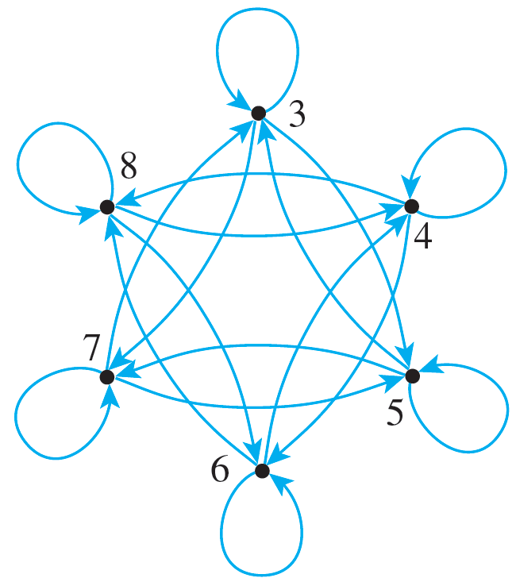
Example 8.1.6 – Solution
continued
The other arrows in the directed graph, as shown below, are obtained by similar reasoning.

Slide 27
N-ary Relations and Relational Databases

Slide 28
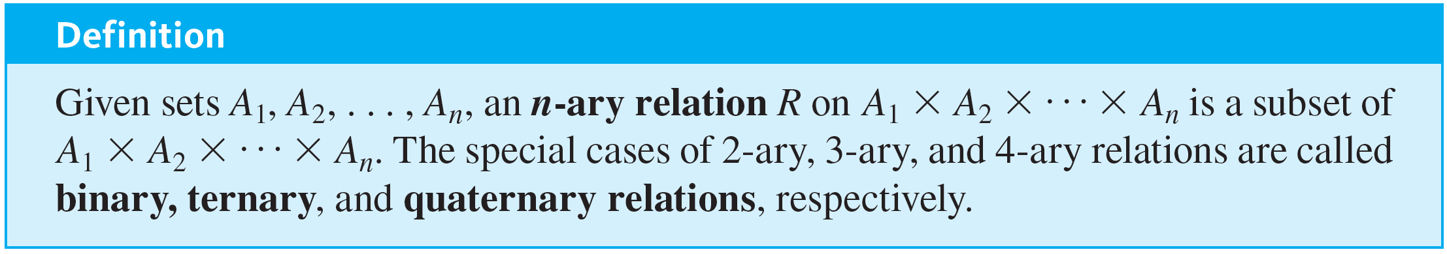
N-ary Relations and Relational Databases
A special group of relations, called n-ary relations, form the mathematical foundation for relational database theory. Just as a binary relation is a subset of a Cartesian product of two sets, an n-ary relation is a subset of a Cartesian product of n sets.

Slide 29
Example 8.1.7 – A Simple Database
The following is a radically simplified version of a database that might be used in a hospital. Let A₁ be a set of positive integers, A₂ a set of alphabetic character strings, A₃ a set of numeric character strings, and A₄ a set of alphabetic character strings. Define a quaternary relation R on A₁ × A₂ × A₃ × A₄ as follows:
(a₁, a₂, a₃, a₄) ∈ R ⇔ a patient with patient ID number a₁, named a₂, was admitted on date a₃, with primary diagnosis a₄.

Slide 30
Example 8.1.7 – A Simple Database
continued
At a particular hospital, this relation might contain the following 4-tuples:
(011985, John Schmidt, 020719, asthma)
(574329, Tak Kurosawa, 011419, pneumonia)
(466581, Mary Lazars, 010319, appendicitis)
(008352, Joan Kaplan, 112419, gastritis)
(011985, John Schmidt, 021719, pneumonia)
(244388, Sarah Wu, 010319, broken leg)
(778400, Jamal Baskers, 122719, appendicitis)

Slide 31
Example 8.1.7 – A Simple Database
continued
In discussions of relational databases, the n-tuples are normally thought of as being written in tables.
Each row of the table corresponds to one n-tuple, and the header for each column gives the descriptive attribute for the elements in the column.
Operations within a database allow the data to be manipulated in many different ways.

Slide 32
Example 8.1.7 – A Simple Database
continued
For example, in the database language SQL, if the above database is denoted S, the result of the query
SELECT Patient_ID#, Name FROM S WHERE
Admission_Date = 010319
would be a list of the ID numbers and names of all patients admitted on 01-03-19:
466581 Mary Lazars
244388 Sarah Wu

Slide 33
Example 8.1.7 – A Simple Database
continued
This is obtained by taking the intersection of the set A₁ × A₂ × {010319} × A₄ with the database and then projecting onto the first two coordinates.
Similarly, SELECT can be used to obtain a list of all admission dates of a given patient. For John Schmidt this list is
02–07–19
02–17–19

Slide 34
Example 8.1.7 – A Simple Database
continued
Individual entries in a database can be added, deleted, or updated, and most databases can sort data entries in various ways.
In addition, entire databases can be merged, and the entries common to two databases can be moved to a new database.

